Slide 1
Ray Marching
w/ Signed Distance Functions

Slide 2
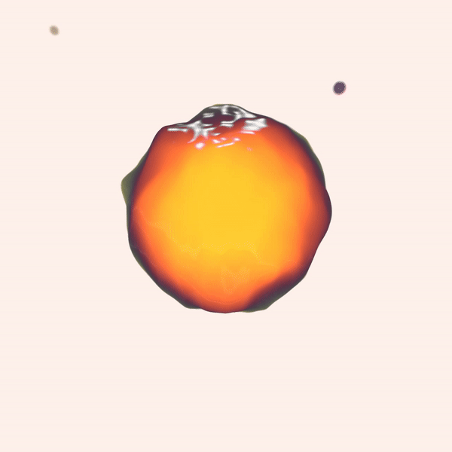

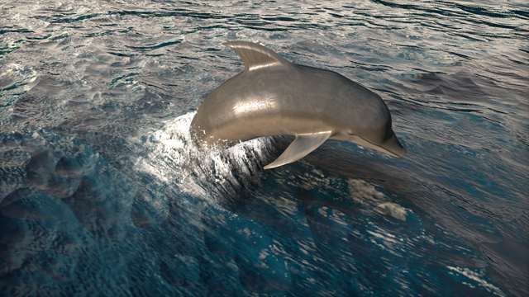
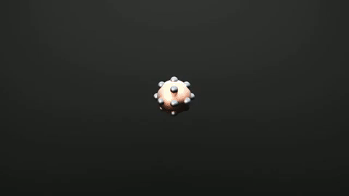
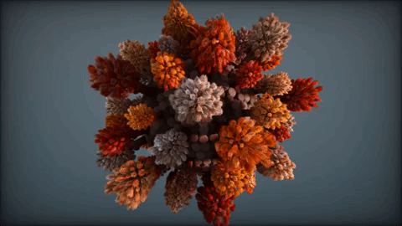
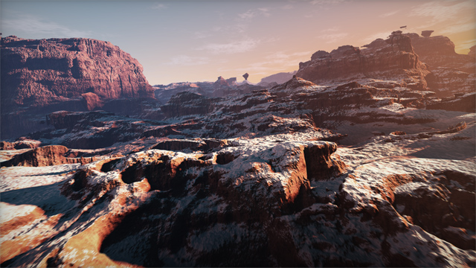
What is it?
Ray marching is an algorithm to render surfaces defined by signed distance functions
Similar to ray tracing
SDFs can represent extremely complex surfaces

Slide 3
Signed Distance Functions

Slide 4
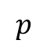
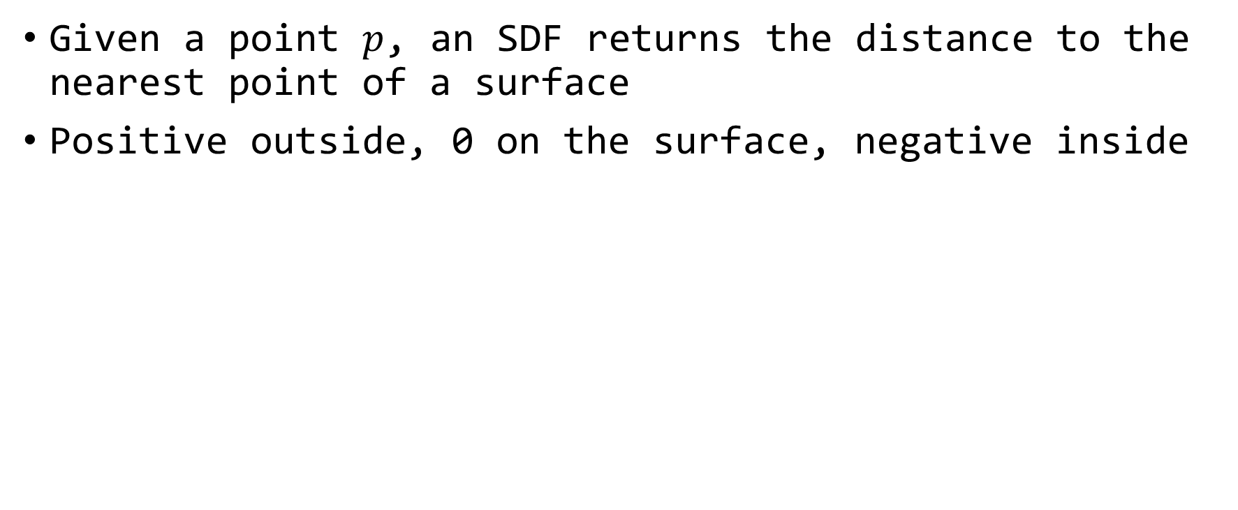
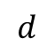
Signed Distance Function
Given a point $p$, an SDF returns the distance to the nearest point of a surface
Positive outside, 0 on the surface, negative inside
$$p$$
$$d$$

Slide 5
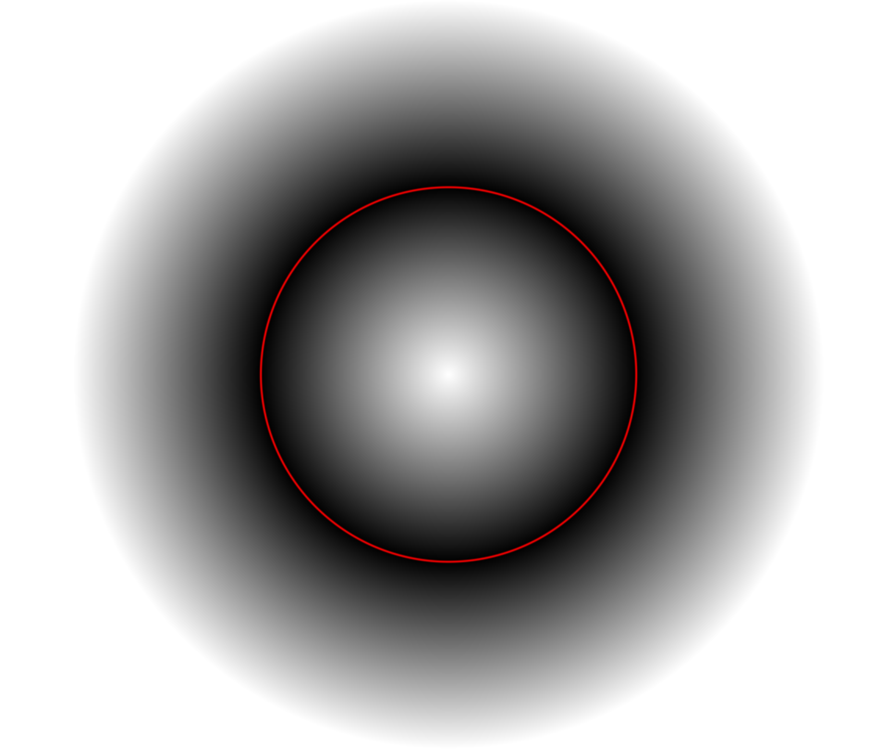
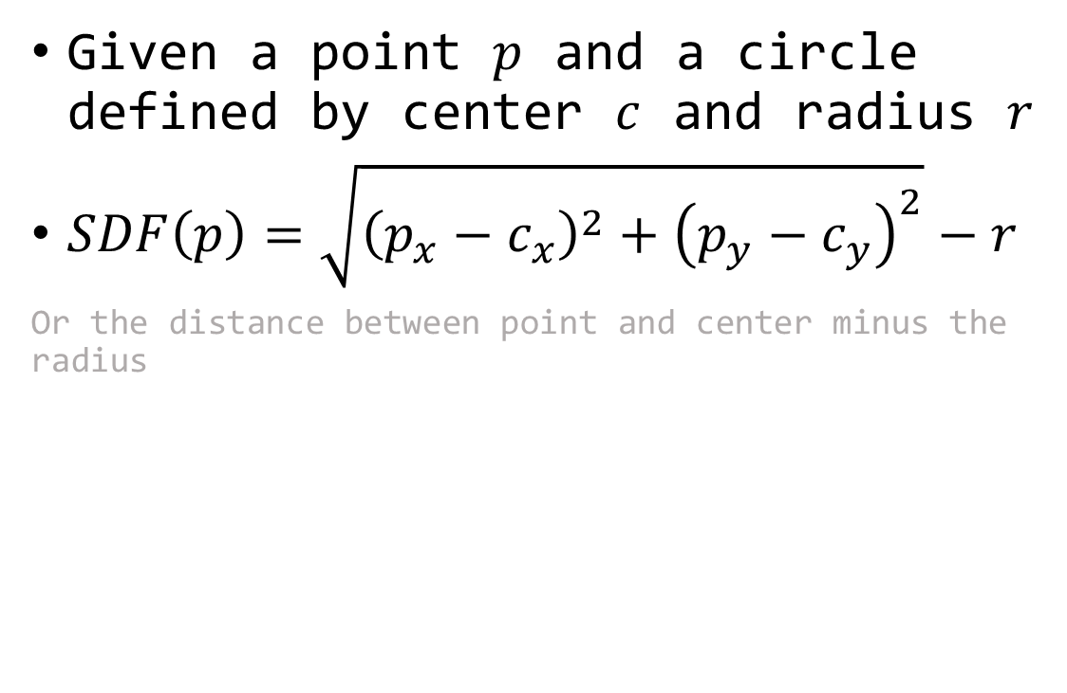
Example with a 2D Circle
Given a point $p$ and a circle defined by center $c$ and radius $r$
$SDF\left(p\right)=\sqrt{{\left(p_{x}−c_{x}\right)}^{2}+{\left(p_{y}−c_{y}\right)}^{2}}−r$
Or the distance between point and center minus the radius

Slide 6
Code in GLSL
float sphereSdf(vec3 point, vec3 center, float radius) {
return length(point - center) - radius;
}

Slide 7
Ray Marching

Slide 8
Ray Marching Basics
For each pixel…
Create a ray from the camera through pixel
March along the ray to find surface intersection
Determine pixel color based on intersection and lights in scene

Slide 9
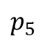
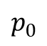
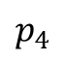
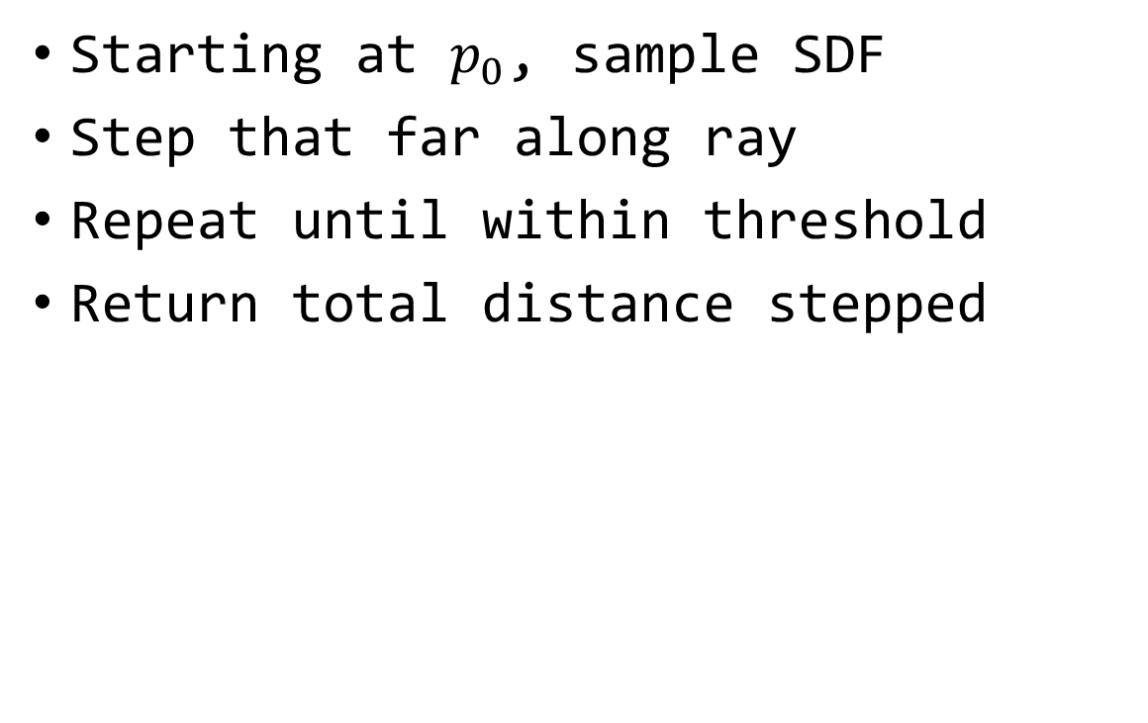
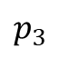
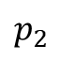
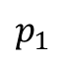
Marching along a Ray
Starting at $p_{0}$, sample SDF
Step that far along ray
Repeat until within threshold
Return total distance stepped
$$p_{0}$$
$$p_{1}$$
$$p_{2}$$
$$p_{3}$$
$$p_{4}$$
$$p_{5}$$

Slide 10
Code in GLSL
float marchRay(vec3 origin, vec3 ray) {
float t = 0.0;
for(int i = 0; i < 100; i++) { // 100 is an arbitrary limit
vec3 p = origin + t * ray;
float dist = sdf(p);
if (dist < 0.0001) return t;
t += dist;
if (t > 20.0) return infinity;
}
return t;
}

Slide 11
Demo
Basic ray marcher
RP logo

Slide 12
Appendix: Math Refresher

Slide 13
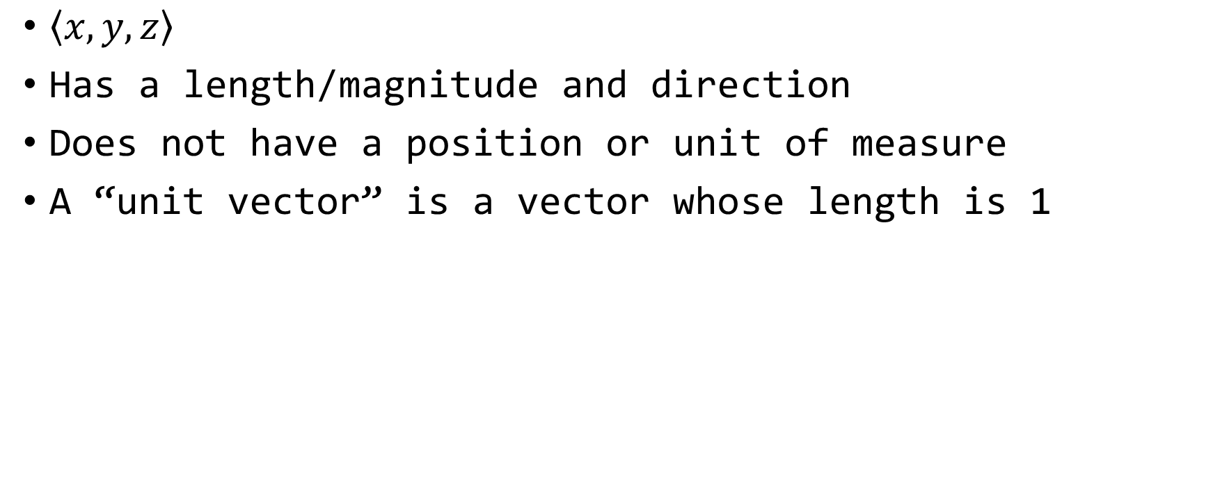
Vector
$\left\langle \left.x,y,z\right\rangle \right.$
Has a length/magnitude and direction
Does not have a position or unit of measure
A “unit vector” is a vector whose length is 1

Slide 14
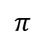
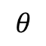
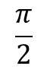
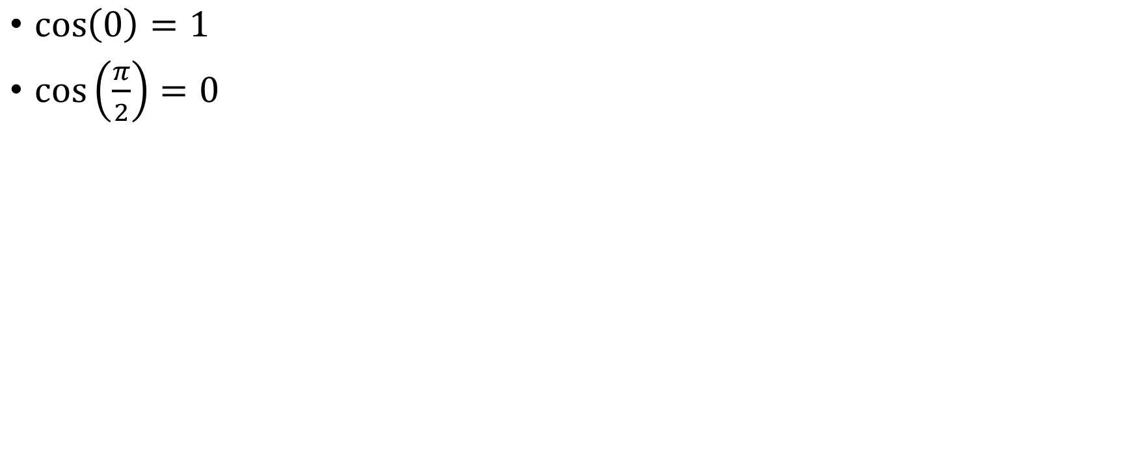

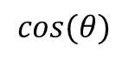

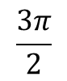
Cosine
$$\frac{π}{2}$$
$\cos\left(0\right)=1$
$\cos\left(\frac{π}{2}\right)=0$
$$1$$
$$π$$
$$θ$$
$$0$$
$$cos(θ)$$
$$\frac{3π}{2}$$

Slide 15
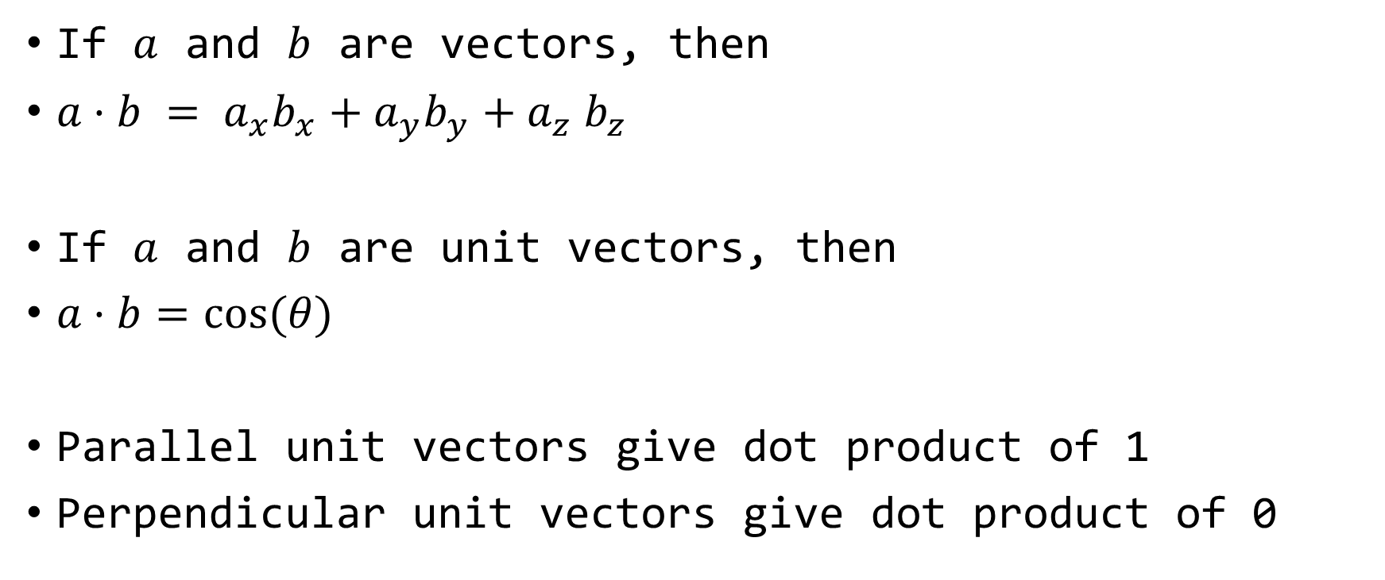
Dot Product
If $a$ and $b$ are vectors, then
$a·b = a_{x}b_{x}+a_{y}b_{y}+a_{z}$ $b_{z}$
If $a$ and $b$ are unit vectors, then
$a·b=cos⁡(θ)$
Parallel unit vectors give dot product of 1
Perpendicular unit vectors give dot product of 0

Slide 16
Appendix: Lighting

Slide 17
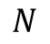
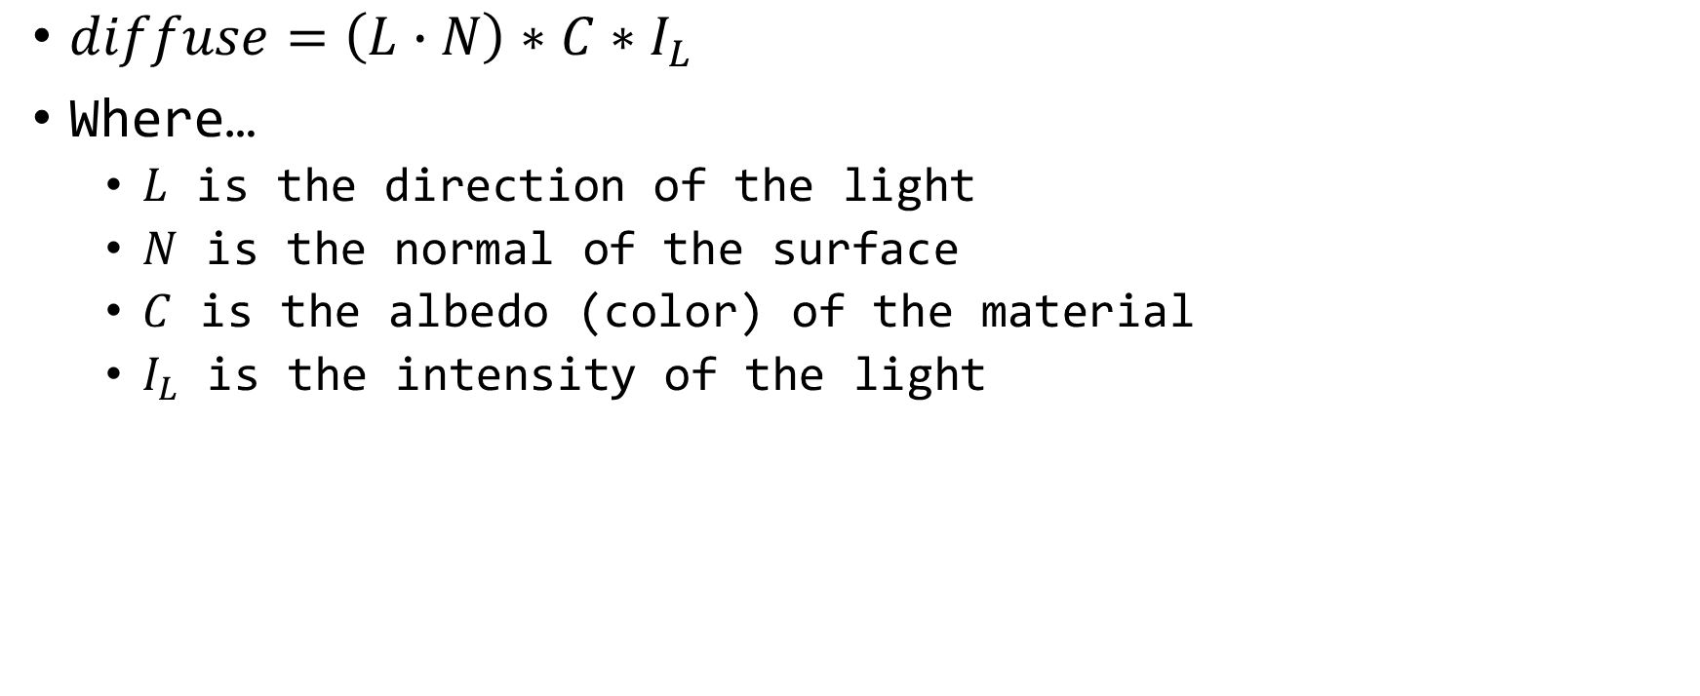
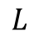
Lambert Diffuse
$diffuse=\left(L∙N\right)∗C∗I_{L}$
Where…
$L$ is the direction of the light
$N$ is the normal of the surface
$C$ is the albedo (color) of the material
$I_{L}$ is the intensity of the light
$$L$$
$$N$$

Slide 18

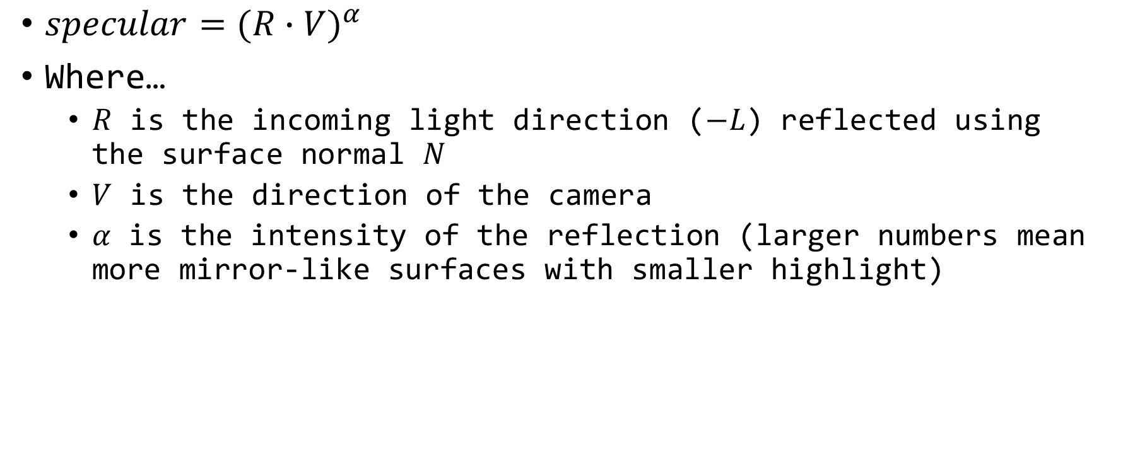
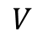
Phong Specular Highlight
$specular={(R∙V)}^{α}$
Where…
$R$ is the incoming light direction ($−L$) reflected using the surface normal $N$
$V$ is the direction of the camera
$α$ is the intensity of the reflection (larger numbers mean more mirror-like surfaces with smaller highlight)
$$L$$
$$N$$
$$R$$
$$V$$

Slide 19
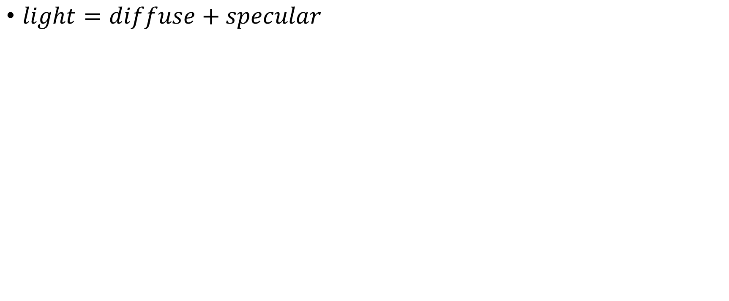
Complete Lighting
$light=diffuse+specular$

